Slide 1
"Optimizing Pricing Strategies and Enhancing Value at Big Mountain Resort"
-By Vaishali Sharma

Slide 2
Introduction and Business Problem
Big Mountain Resort, offers a range of facilities and scenic views, attracting approximately 350,000 visitors annually.
The resort has recently added an additional chair lift, increasing operating costs by $1,540,000 this season.
Business Problem
The current pricing strategy is based on market averages, which may not fully leverage the resort's unique facilities.
There is a need to determine a better pricing strategy that accurately reflects the value of the resort’s offerings to optimize revenue and guide investment decisions.

Slide 3
Problem Identification (continued)
Challenges:
Reliance on market averages
Inadequate consideration of unique resort features
Goal: Develop data-driven pricing and facility management strategies.

Slide 4
Pricing Adjustment Recommendation
Recommended Price: $97.96
Key Findings:
Current underpricing by $16.96
Seasonal peaks in revenue
Varied price sensitivity among customer segments
Competitor pricing impacts

Slide 5
Data Sources and Cleaning
Data Sources:
Financial records
Customer surveys
Visitor demographics
External factors
Data Cleaning:
Imputation of missing values
Duplicate removal
Normalization

Slide 6
Problem and Objectives
To develop a model that predicts the optimal adult weekend ticket price for Big Mountain Resort.
Objectives
Analyze current pricing strategy and identify gaps.
Use data-driven methods to determine the impact of various facilities on ticket pricing.
Propose a new pricing strategy to maximize revenue.
Data Preparation
Initial data contained ticket price values with several missing entries.
Additional data on US state population and size were incorporated and cleaned to enhance the dataset.

Slide 7
Exploratory Data Analysis (EDA)
Key Insights from EDA
Various features such as skiable area, resort density, and days open were examined to understand their correlation with ticket prices.
A feature correlation heatmap was used to identify the most influential factors affecting ticket prices.
Scatterplots were created to visualize the relationship between numeric features and ticket prices.
Conclusion
The analysis highlighted significant variables that should be considered in the new pricing strategy.
The resort can utilize these insights to adjust prices dynamically based on the value offered by different facilities.

Slide 8
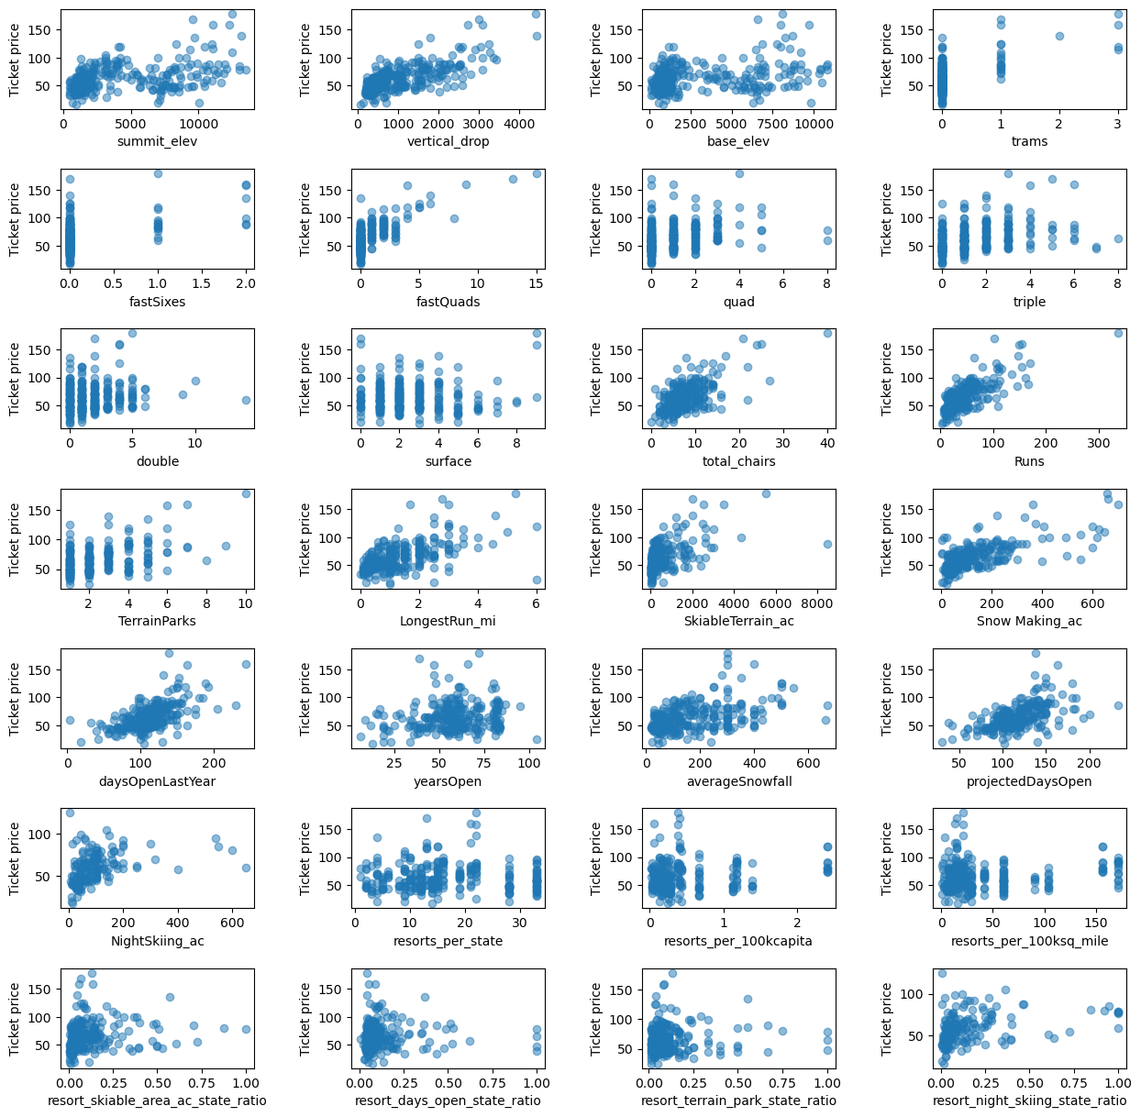
Exploratory Data Analysis (EDA) (Continued)
There's a strong positive correlation with vertical_drop. fastQuads seems very useful. Runs and total_chairs appear quite similar and also useful. resorts_per_100kcapita shows something interesting that you don't see from just a headline correlation figure. When the value is low, there is quite a variability in ticket price, although it's capable of going quite high.

Slide 9
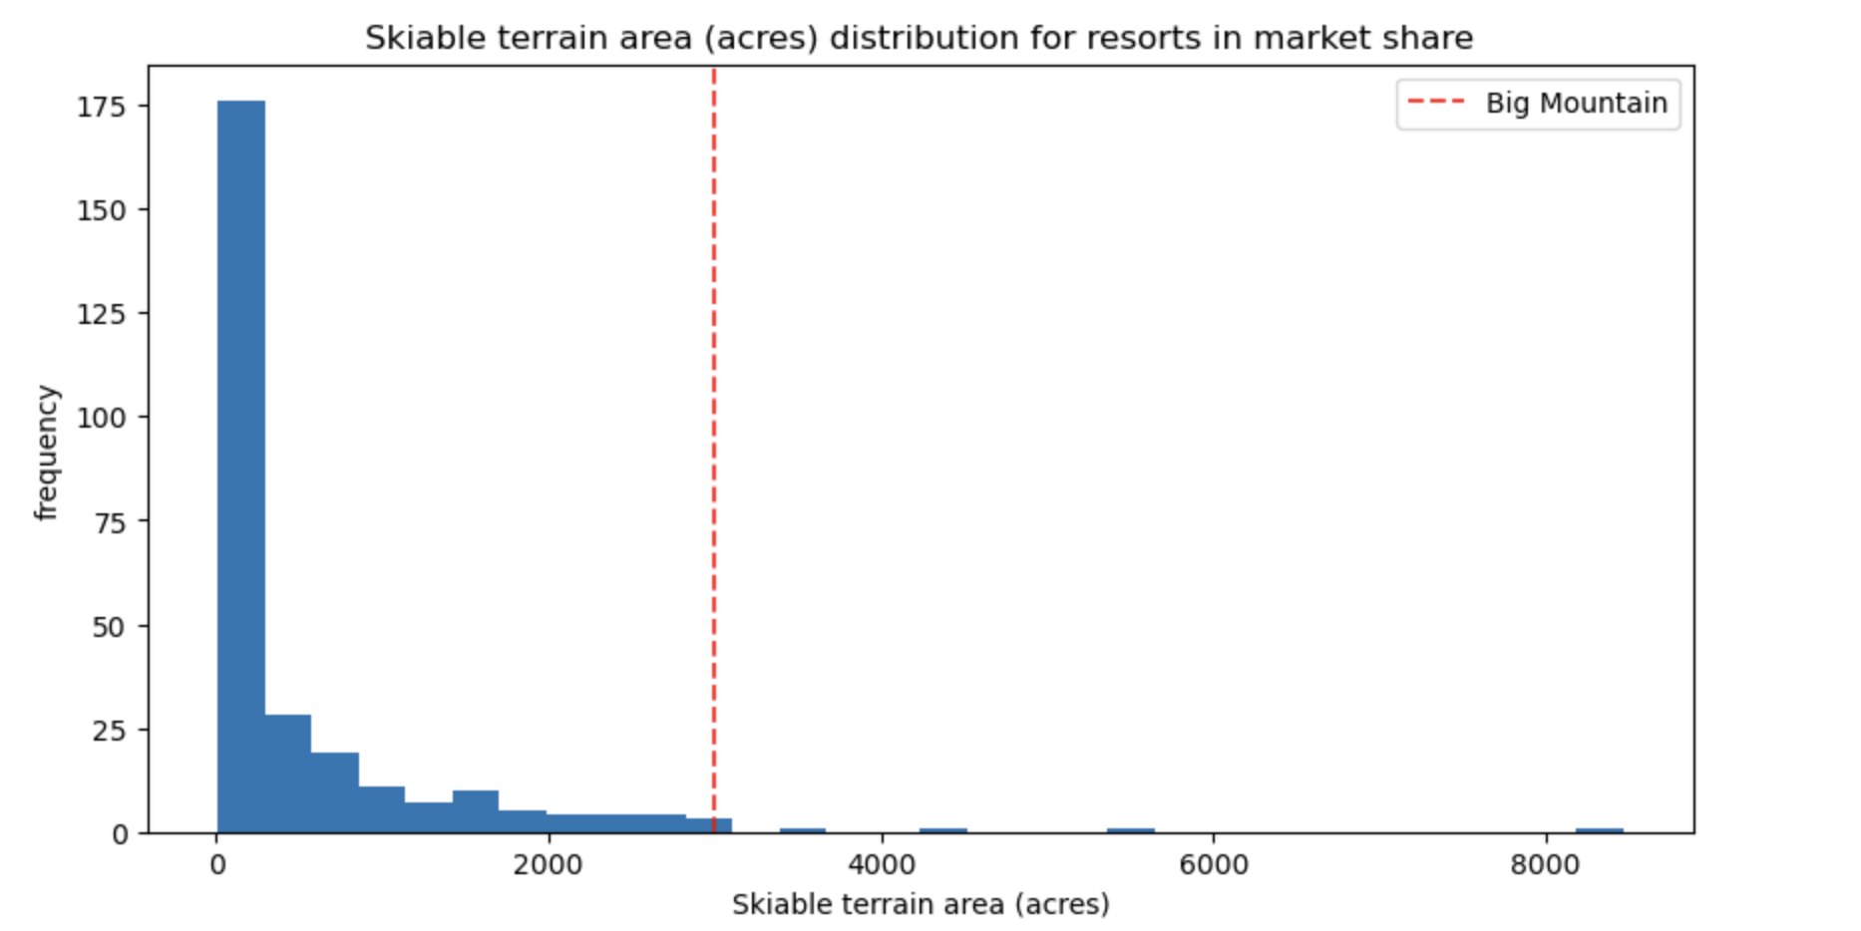
Big Mountain is amongst the resorts with the largest amount of skiable terrain.

Slide 10
Paving the Path to Profit: Strategic Enhancements and Future Focus
Conclusion
Current Underpricing: $16.96 below market-supported price
Optimizing pricing through data-driven strategies will:
Enhance customer satisfaction
Boost revenue
Future Scope of Work
Enhancing Data Collection
Collect detailed data on operating costs, visitor behavior, and external factors.
Model Refinement
Continuously update the predictive model with new data and advanced techniques.
Expanding Scenario Modeling
Explore additional scenarios to assess their impact on revenue and satisfaction.
Training and Documentation
Provide ongoing training and detailed documentation for effective model usage by business analysts.

